Slide 1
Image classification with Convolutional Neural Networks
Authors: Hubert Ruczyński, Patryk Tomaszewski 28th March 2023

Slide 2
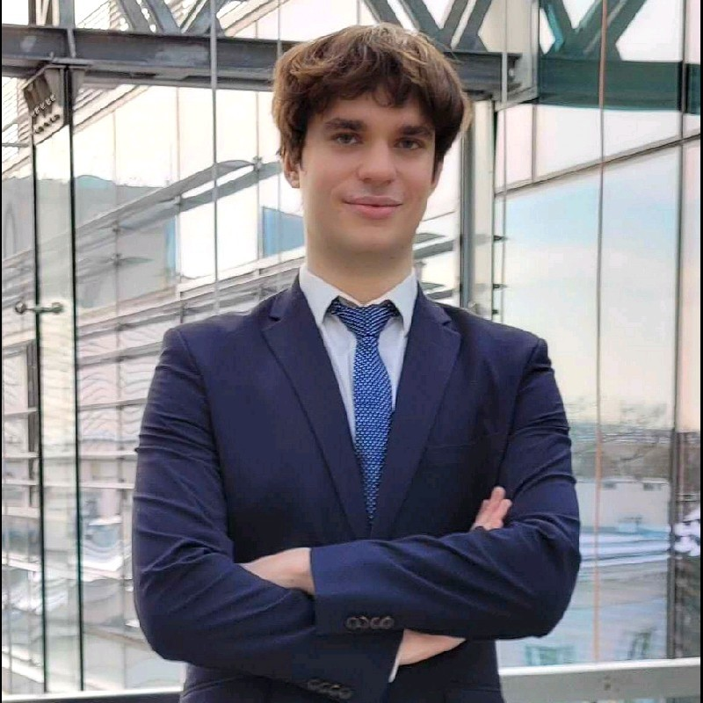
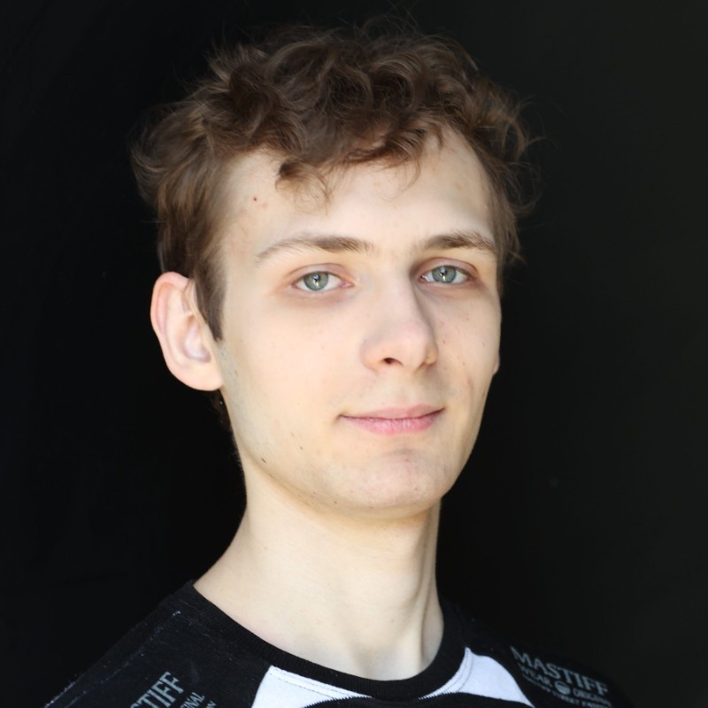
Authors
Hubert Ruczyński (BSc)
GitHub: https://github.com/HubertR21
LinkedIn: https://www.linkedin.com/in/hubertr21/
Patryk Tomaszewski (BSc)
GitHub: https://github.com/Filmos
LinkedIn: https://www.linkedin.com/in/tomaszewski-p/

Slide 3
01
Dataset: CIFAR-10

Slide 4
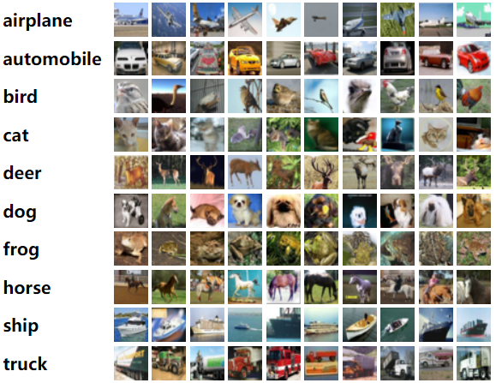
CIFAR-10
Authors: Alex Krizhevsky, Vinod Nair, and Geoffrey Hinton
Year: 2009
Purpose: Benchmark for computer vision research
Specification: Relatively small size of the dataset makes it possible to train CNNs on the entire dataset using modest computing resources.
Train obs. | Test obs. | Total obs. | Imgage Size | Colour | Classes | Max Acc
50 000 | 10 000 | 60 000 | 32x32 | Yes | 10 | 99.5

Slide 5
02
Selected CNN architectures

Slide 6
CNN architecures
1. Mobile Net V3 Small (random initialization) + resizing 128 x 128
2. Mobile Net V3 Small (pretrained) + resizing 128 x 128
3. Efficient Net (pretrained) + resizing 64 x 64
4. Custom CNN ((2 Convolutional layers + Max pooling) x 3)
And the same classification network for 1-4:
Dense layer 64 + Dense layer 32 with relu activation and customisable dropout and regularisation.

Slide 7
03
Experiment 1: hyper-parameters

Slide 8
PC Specification
Package | Version
scikit-learn | 1.2.2
keras cv | 0.3.5
tensorflow datasets | 4.8.3
pycocotools | 2.0.6
keras | 2.10.0
pandas | 1.5.3
numpy | 1.24.2
seaborn | 0.12.2
matplotlib | 3.7.1
typing-extensions | 4.5.0
Keras-Preprocessing | 1.1.2
pyarrow | 11.0.0
tensorflow | 2.10.1
tqdm | 4.61.2
Component | Specification
OS | Windows 11
CUDA | CUDA 12.1.0
GPU | GPU Ge Force RTX 3070 Ti (24GB – 8GB/16GB)
CPU | Intel Core i7-11700KF 3.6GHz
RAM | 32GB

Slide 9
Experiment Description
Main goal: Analyse the impact of training hyper-parameters.
Secondary goal: Greedy selection of best parameters.
Number of repetitions: 5
Computational time: 14 hours
Additional notes: Initially we wanted 5 values for the batch size, but we got OOM Error for bigger values, and smaller calculated for a ages.
Learning rate | 0.01 | 0.05 | 0.1 | 0.2 | 0.5
Batch size | 64 | 96 | 128
Dropout rate | 0 | 0.2 | 0.4 | 0.6 | 0.8
L2 regularisation | 0 | 0.2 | 0.5 | 0.7 | 1

Slide 10
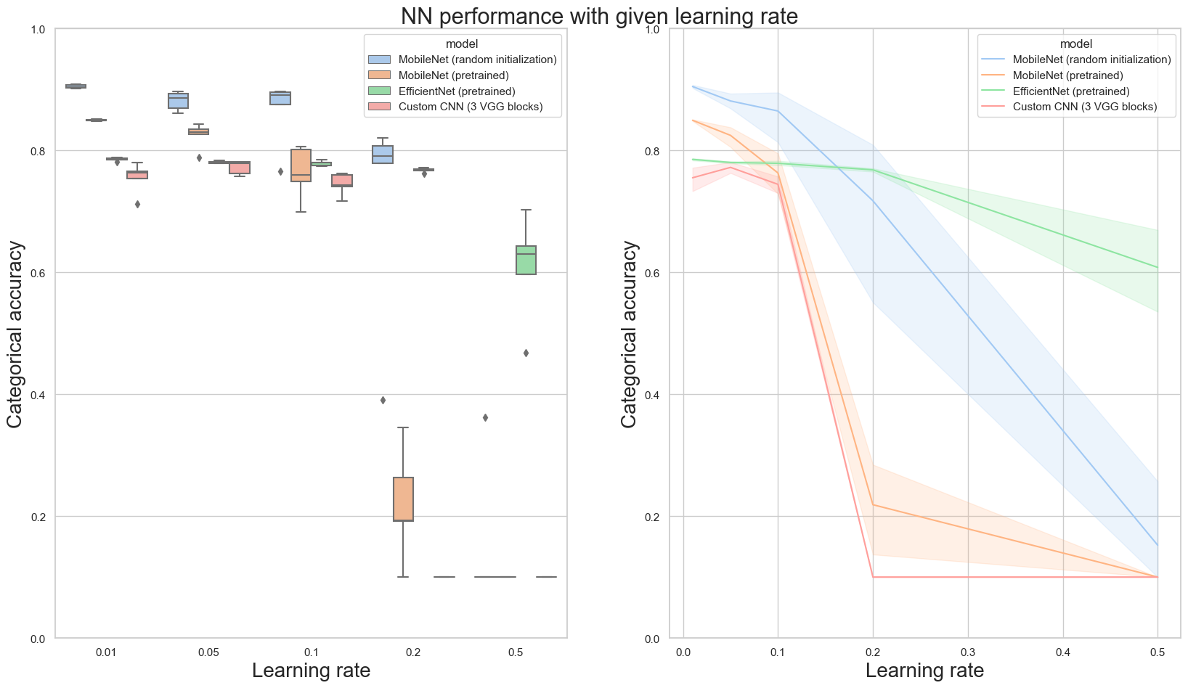
Learning rate values

Slide 11
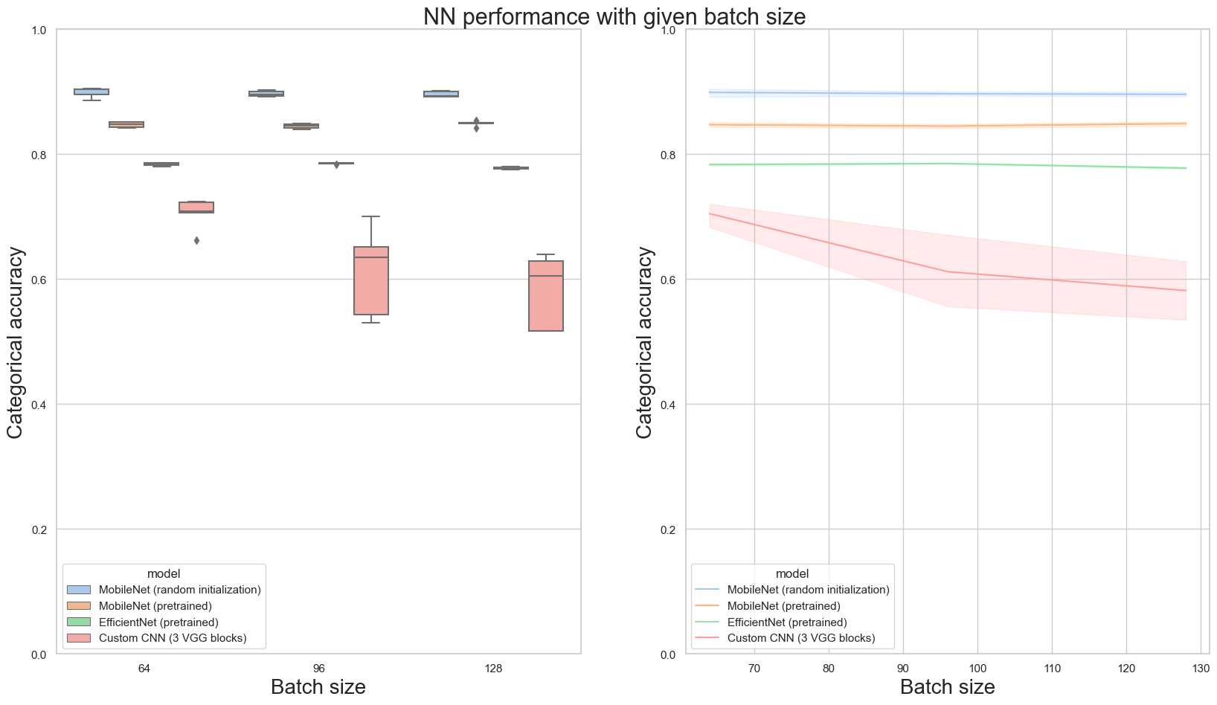
Batch size values

Slide 12
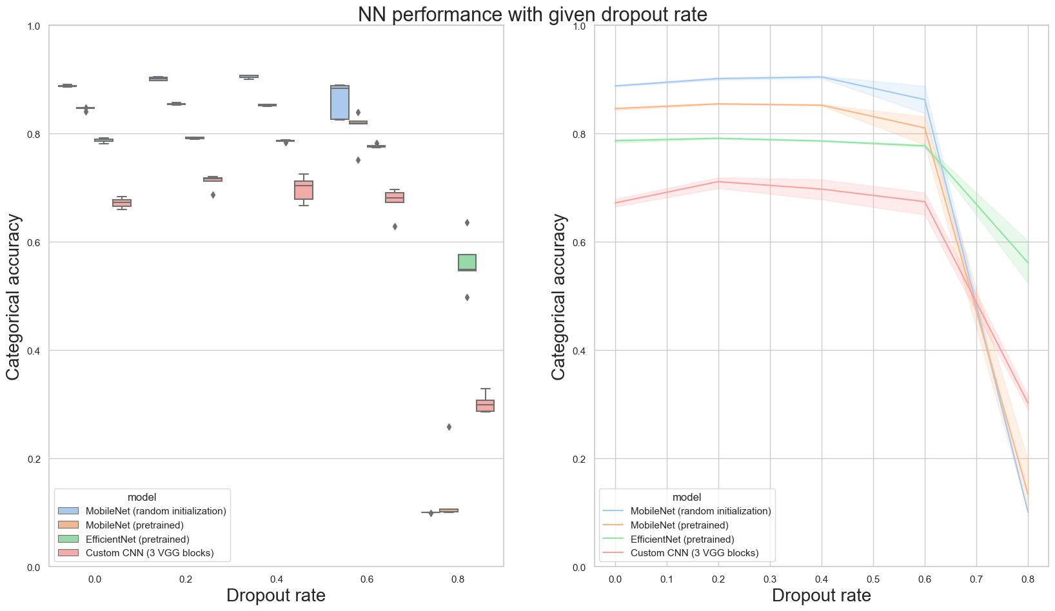
Dropout rate values

Slide 13
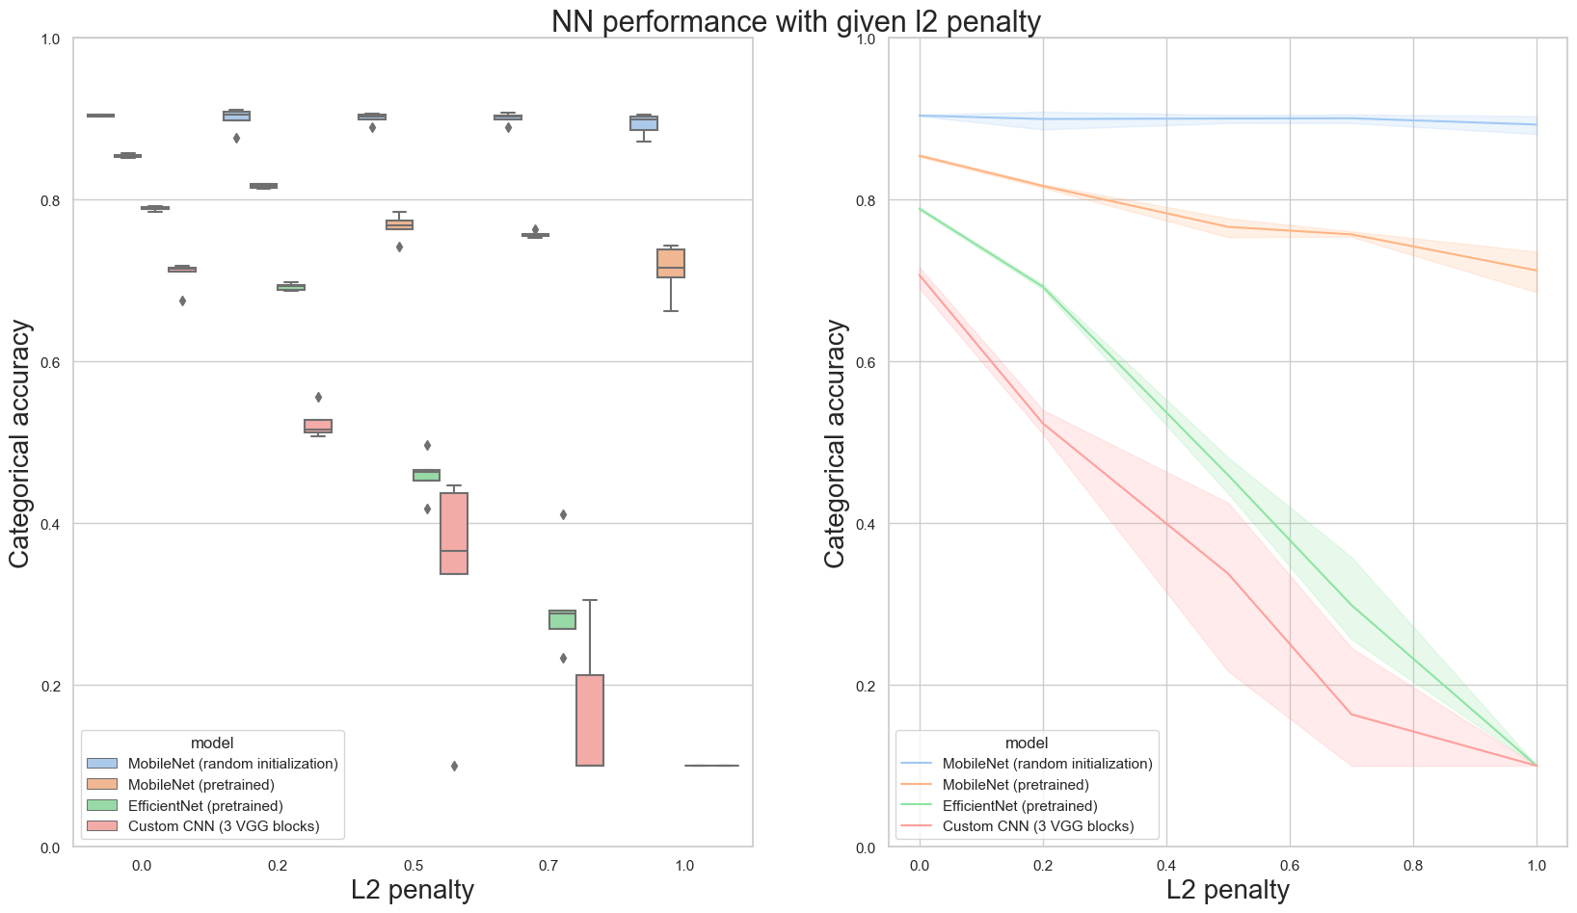
L2 penalty values

Slide 14
04
Experiment 2: Augmentation

Slide 15
Experiment Description
Main goal: Analyse the impact of different augmentation methods.
Secondary goal: Generate additional outcomes for ensembles.
Number of repetitions: 5
Computational time: 2 hours
Additional notes: The augmentation was run on the best model from Experiment 1, which was a Mobile Net with random initialization:
Learning rate: 0.01
Batch size: 64
Dropout rate: 0.2
L2: 0
Shifting | 1
Contrast | 2
All | 3
Cut-mix | 4
Cropping | 5

Slide 16
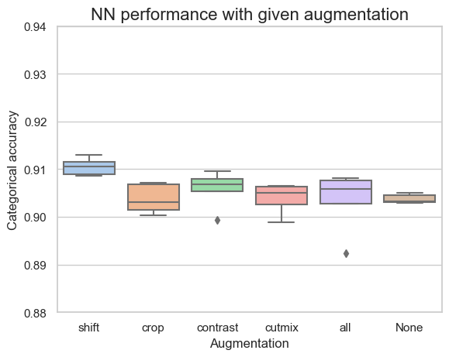
Different augmentation results

Slide 17
05
Experiment 3: Ensembles

Slide 18
Experiment Description
Main goal: Compare the models and different ensembles outcomes
Number of repetitions: 6 different cutoffs
Computational time: 15 minutes
Additional notes: Best / worst model accuracy: 91.29% / 9.95%
Percentage of models | Accuracy soft voting | Accuracy hard voting
100% | 92.17% | 91.21%
50% | 92.82% | 92.52%
40% | 92.71% | 92.49%
30% | 93.06% | 93.04%
20% | 92.86% | 92.84%
10% | 92.99% | 93.07%

Slide 19
06
Kaggle results

Slide 20
Kaggle results
Architecture | Learning rate | Batch size | Dropout | L2 reg. | Augmentation | Accuracy
Mobile Net (Random) | 0.01 | 64 | 0.2 | 0 | shift | 90.25%

Slide 21
Thanks for attention!

